Slide 1

Department of Electronics & Communication Engineering
Major Project (18ECP83) Presentation
on
“Design and Verification of AMBA APB Protocol Using System Verilog”
Project Associates
Abhinandan k (4GM20EC001)
Basavaraj A S (4GM20EC018)
Danesh S A (4GM20EC025)
Likhith G K (4GM20EC054)
Project Guide
Dr. Praveen J
Head of the Department

Slide 2
Contents
Introduction
AMBA
Literature survey
Objectives
Signals
Operational States
Transfers
Error response
Simulation Result
Conclusion
References

Slide 3
Introduction
The APB Protocol is non-pipeline Protocol.
In APB every transfer takes at least two cycles setup phase and access phase.
It is connected to the system via a bridge, helps to reduce system power consumption.
The APB can interface with AHB, AXI and etc..

Slide 4
AMBA
Advance Microcontroller Bus Architecture (AMBA) is an architecture that is widely used in system-on-chip designs , which are found on chip buses.
The AMBA specification standard is used for designing high level embedded microcontrollers.
It provide technology independence and to encourage modular system design.

Slide 5
Literature survey
Author | Title | Year of Publication | Remarks
Shankar, Dipti Girdhar | “Design and Verification of AMBA APB Protocol” | 2014 | The AMBA bus architecture and discusses the APB bus in detail. The APB bus is designed using the Verilog
Vaishnavi R.K, Bindu. S, Sheik Chand Basha | “Design and Verification of APB Protocol by using System Verilog and Universal Verification Methodology” | 2019 | AMBA bus architecture and discusses the APB bus in detail
Mukunthan J, A Daniel Raj, and Shruthi T | "Design and Implementation of AMBA APB Protocol" | 2021 | Explains its significance in embedded system designs. It would discuss how the APB protocol facilitates communication between the CPU (Central Processing Unit) and peripherals in ARM-based systems.
Anushka Dwivedi, Dr. Anand Jati | “Design and implementation of AMBA APB protocol using system Verilog” | 2022 | The goal was to integrate this model as technology advances, SoC designs get more sophisticated. As technology advances, SoC designs get more sophisticated

Slide 6
Objectives
To ensure compliance with the AMBA APB protocol, the designed AMBA APB interface strictly aligns with the specifications outlined in the protocol.
To ensure that the AMBA APB interface operates correctly, enabling seamless communication between the central processing unit (CPU) and peripheral modules without errors.
To design the AMBA APB interface in a modular manner to facilitate reusability and flexibility for various data widths, address spaces, and peripheral configurations.

Slide 7
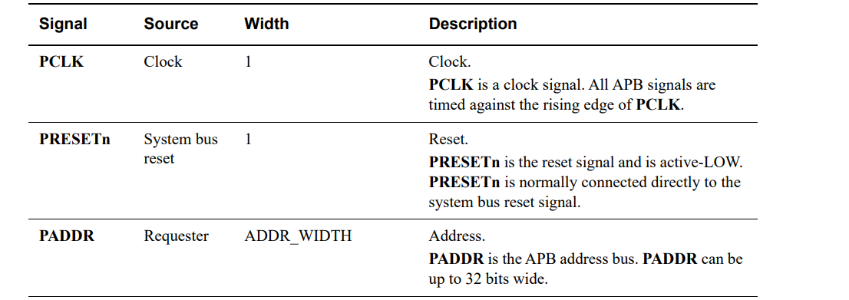
Signals

Slide 8
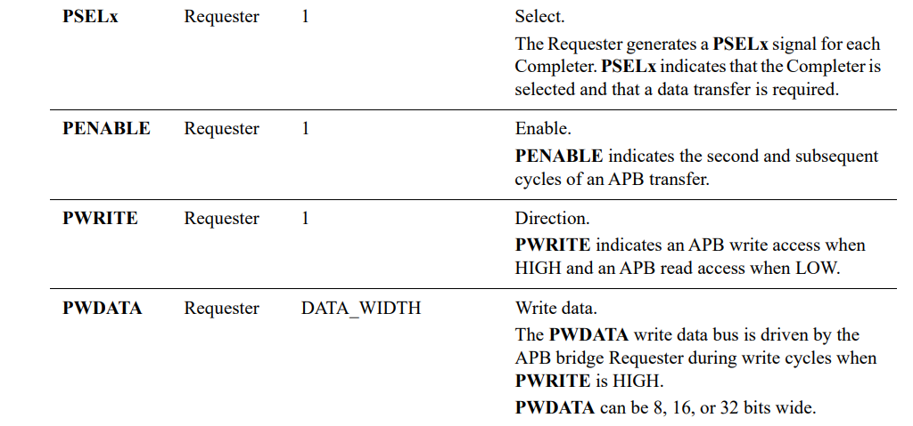

Slide 9
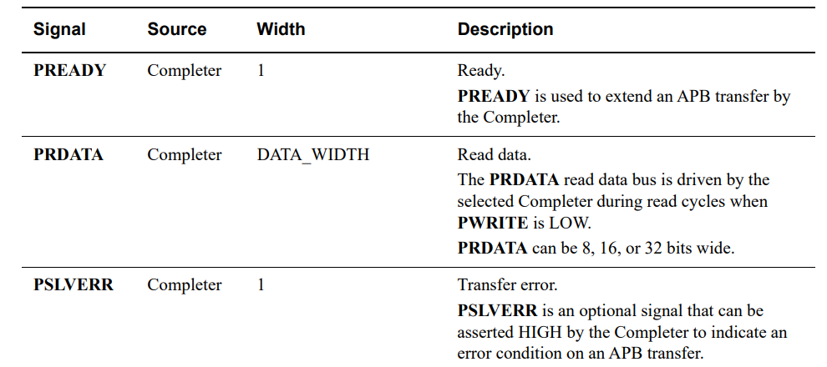

Slide 10
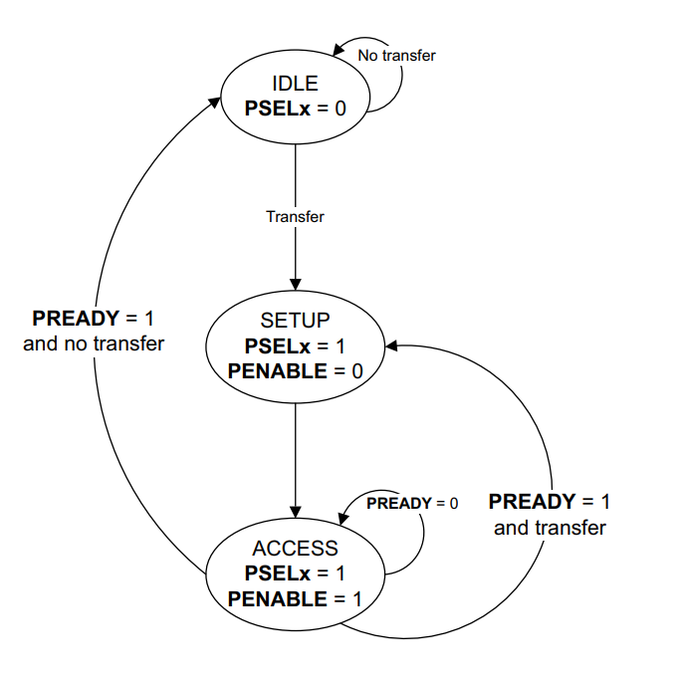



Operational States
Figure 1: State diagram

Slide 11
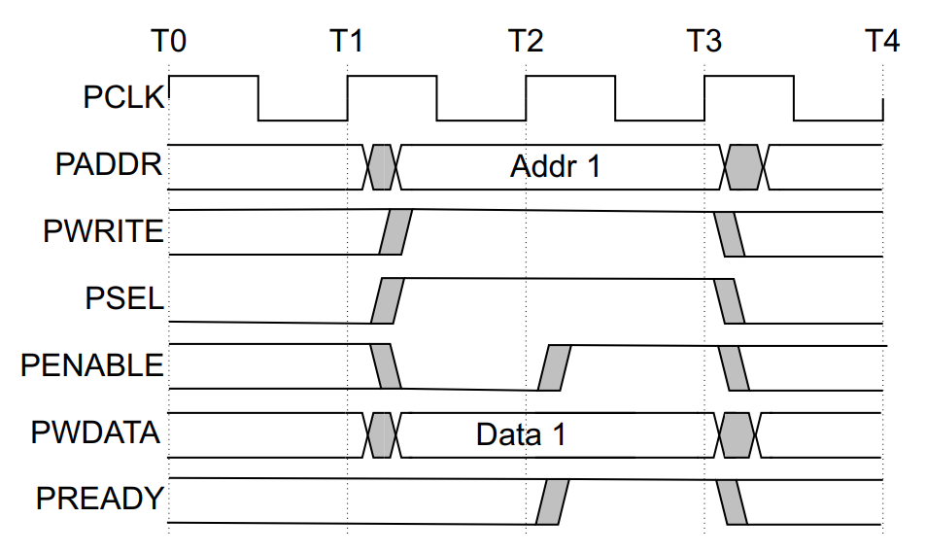
Transfers
Figure 2: Write transfer

Slide 12
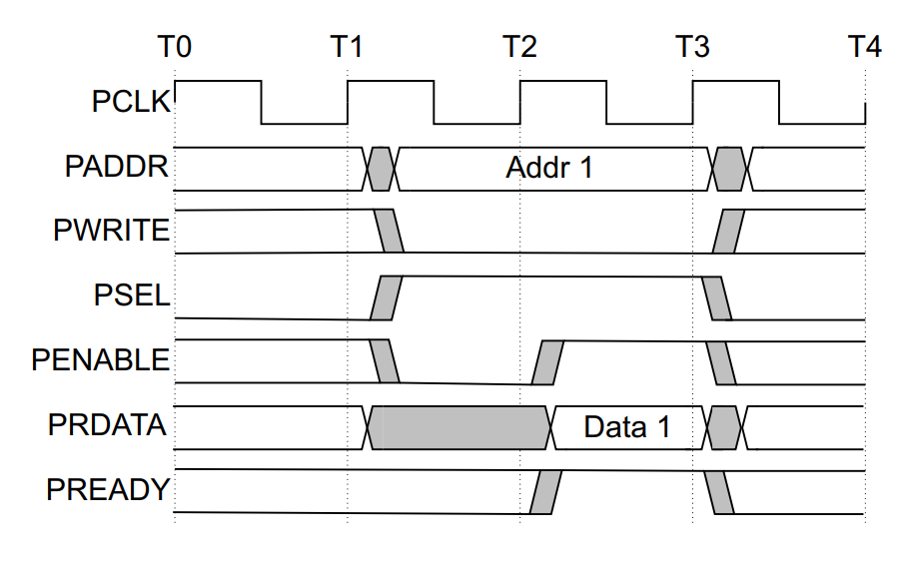
Figure 3: Read transfer

Slide 13
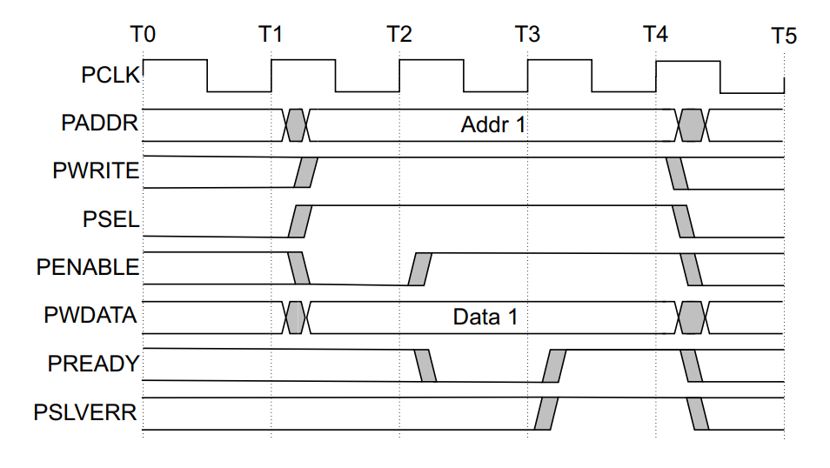
Error response
Figure 4: Unsuccessful write transfer

Slide 14
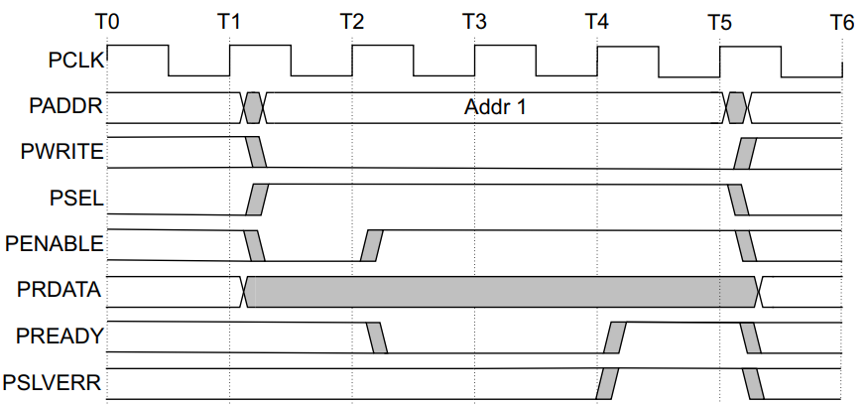
Figure 5: Unsuccessful read transfer

Slide 15
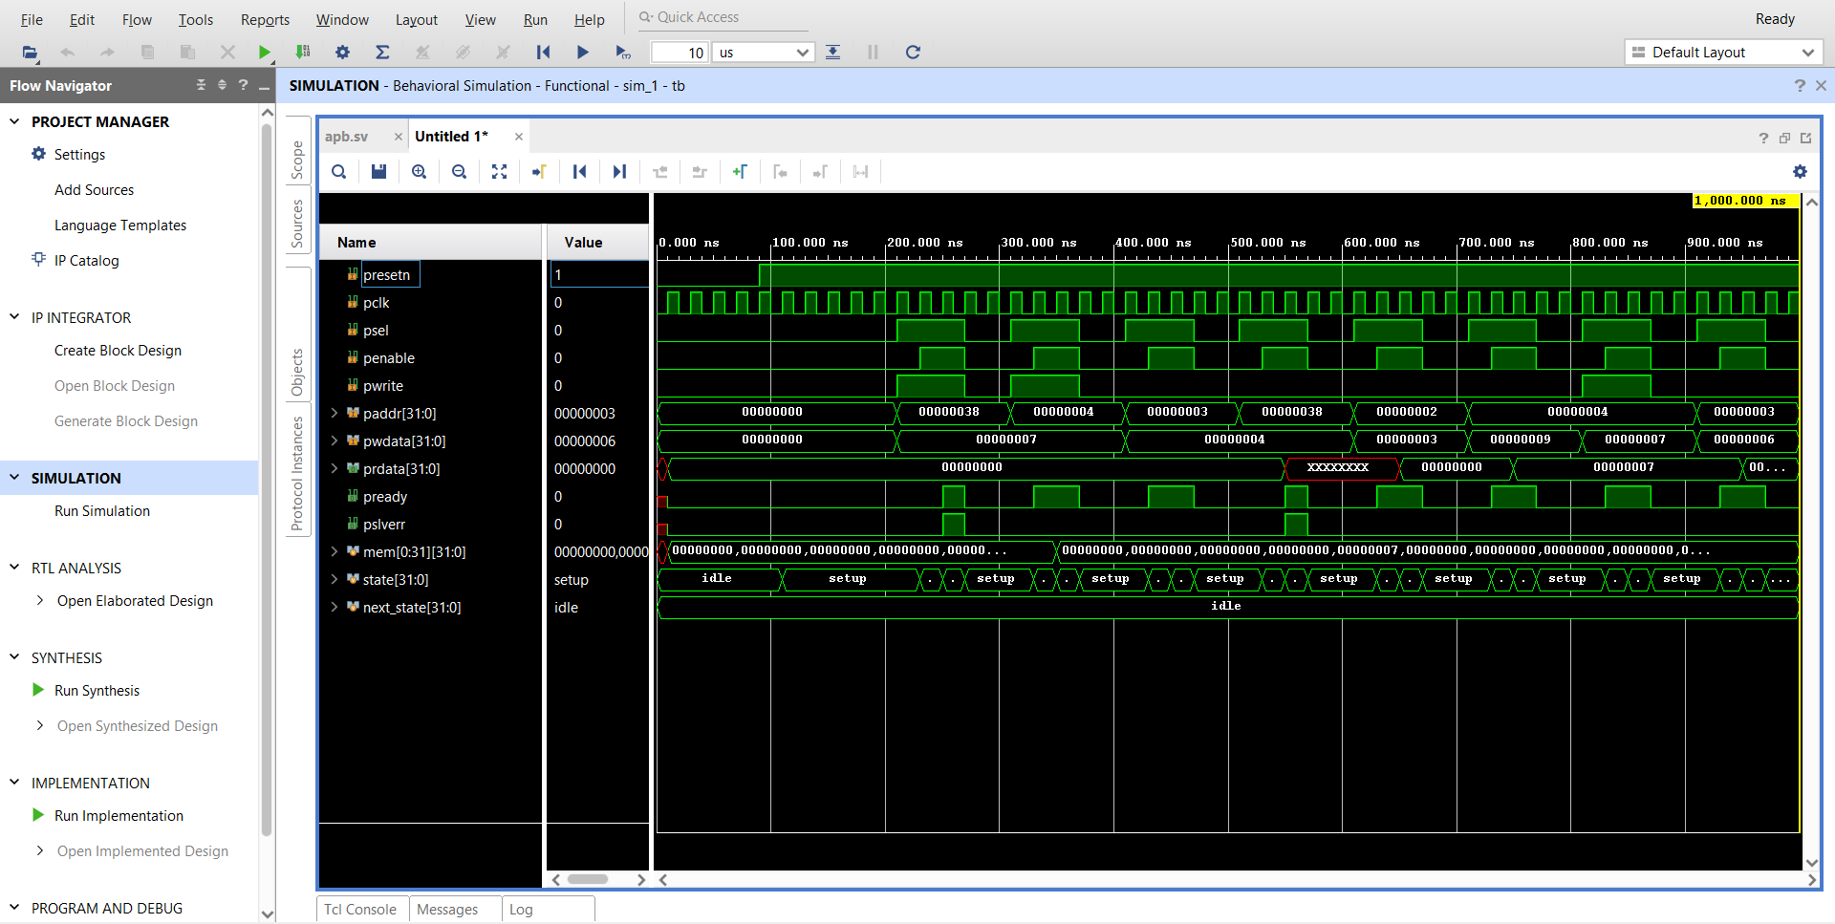
Simulation Result
Figure 5: Simulation Result Waveform

Slide 16
Conclusion
This project addresses the complexities involved in designing and verifying high-performance bus protocols for on-chip communication.
Demonstrates a methodical approach to model the AMBA APB protocol, highlighting its flexibility and efficiency in handling high-speed data transfers.
In conclusion, this project exemplifies the critical role of advanced verification techniques in ensuring the integrity and performance of digital communication protocols.

Slide 17
References
[1] Dipti Girdhar Shankar, “Design and Verification of AMBA APB Protocol”, International Journal of Computer Application, Vol. 95 Issue. 21, June 2014.
[2] Vaishnavi R.K, Bindu. S, Sheik Chandbasha “Design and Verification of APB Protocol using System Verilog and Universal Verification Methodology”, International Research Journal of Engineering and Technology (IRJET), Vol. 6, Issue. 06, June 2019.
[3] Mukunthan J, A Daniel Raj, Shruthi T “Design and Implementation of AMBA APB Protocol”, IOP Conference Series: Materials Science and Engineering, 2021.
[4] Anushka Dwivedi, Anand Jati “DESIGN AND IMPLEMENTATION OF AMBA APB PROTOCOL USING SYSTEM VERILOG” Volume:04, Issue:07, July-2022.

Slide 18
THANK
YOU

